Slide 1


How can we address water scarcity?
Short-term responses:
Immediate actions taken to reduce the impact of water scarcity quickly. These strategies focus on coping with current shortages and preventing urgent problems. They are usually temporary.
Long-term responses:
Planned actions designed to prevent or manage water scarcity in the future. The focus is on sustainability, efficiency, and adapting water systems over time.
Complete the worksheet, identifying whether each strategy is short or long term and why.
Notes:
Worksheet 7.1

Slide 2

Example: Desalination
Desalination is a long term strategy, aiming to address water scarcity.
It involves filtering salt water (such as from the Ocean) and turning it into freshwater. Watch the video and create a diagram of the process of desalination.
Notes:
Worksheet 7.2
https://www.youtube.com/watch?v=YHt18r2L5j8

Slide 3
Example: Desalination
Read the information on Desalination and think about its short and long term benefits and disadvantages.
Is it a worthwhile strategy for governments to invest in to?
Notes:
Worksheet 7.2
https://www.youtube.com/watch?v=YHt18r2L5j8

Slide 4
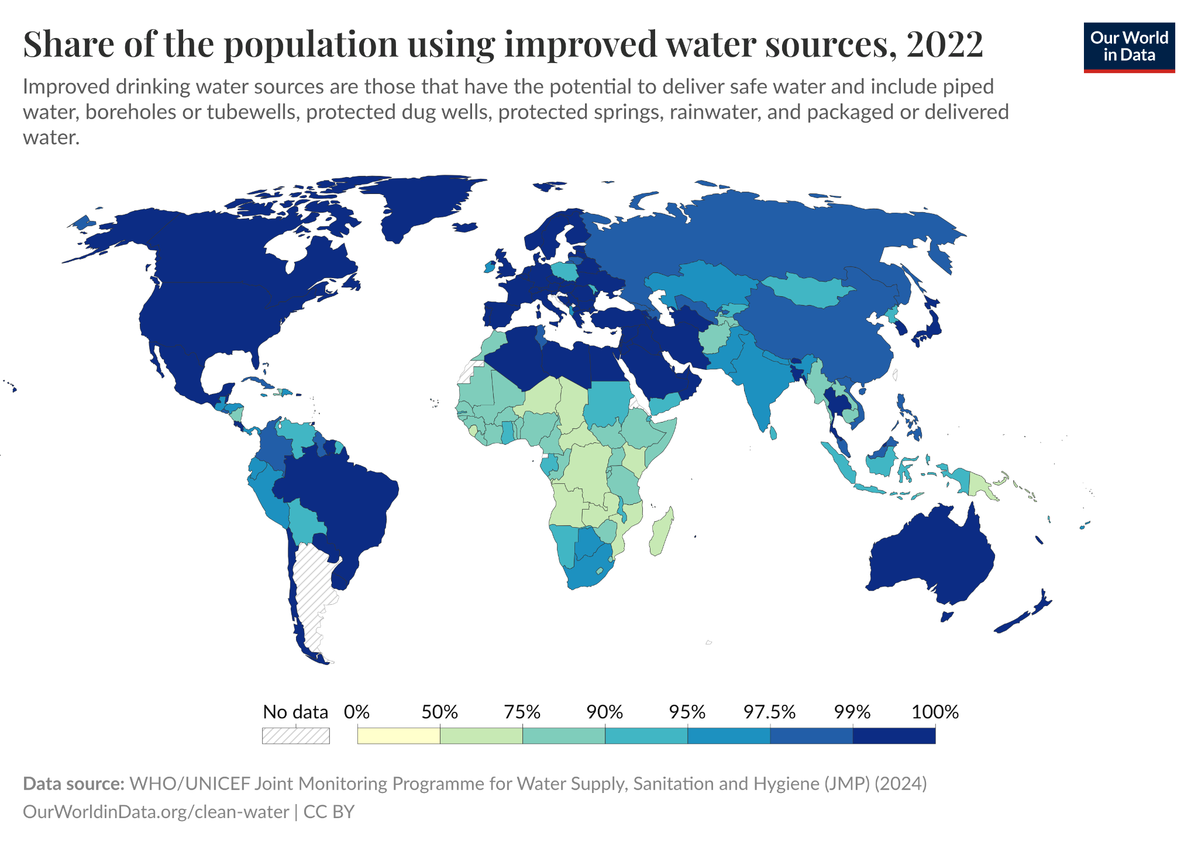
Who has high quality water?
Some places have access to improved water sources. These are long term water supplies that are protected from contamination, such as piped water, protected wells, boreholes, rainwater tanks and properly maintained public standpipes

Slide 5
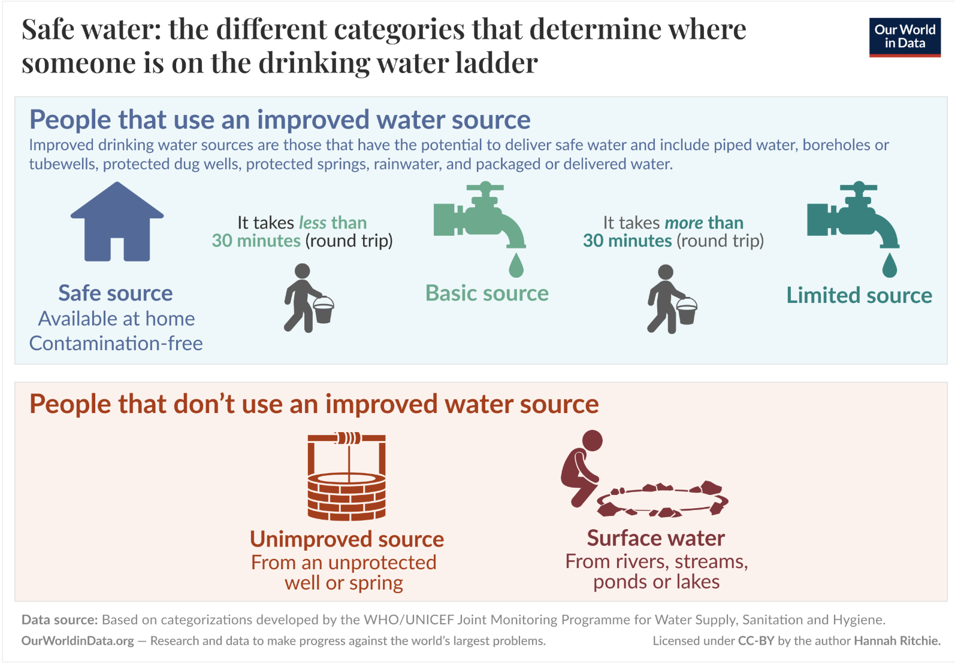
Source: Our World in Data

Slide 6
Improved water sources
Some places have access to improved water sources. These are water supplies that are protected from contamination, such as piped water, protected wells, boreholes, rainwater tanks and properly maintained public standpipes
Create a line graph demonstrating the change in access to improved water sources for different places in the world and answer the questions.
Notes:
Worksheet 7.3

